Slide 1


Slide 2
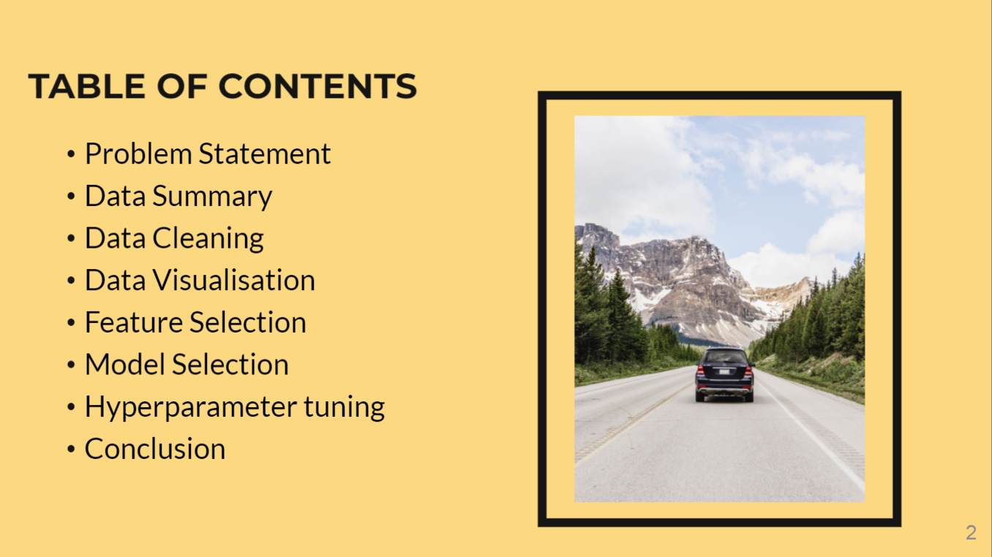

Slide 3
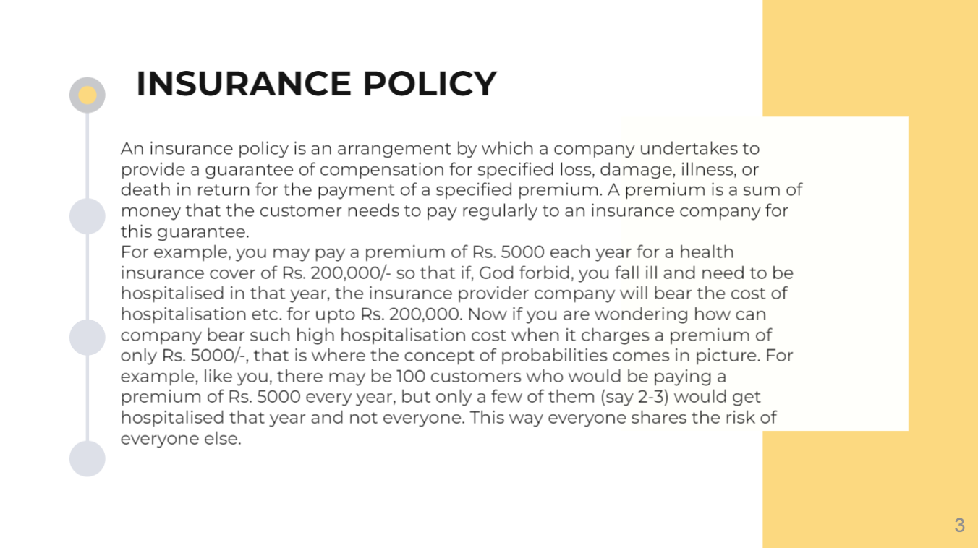

Slide 4


Slide 5


Slide 6
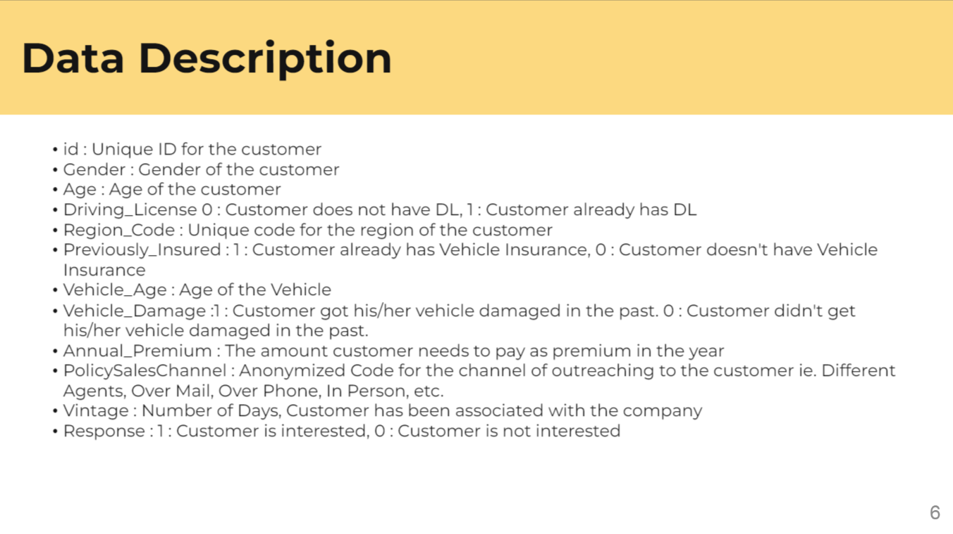

Slide 7
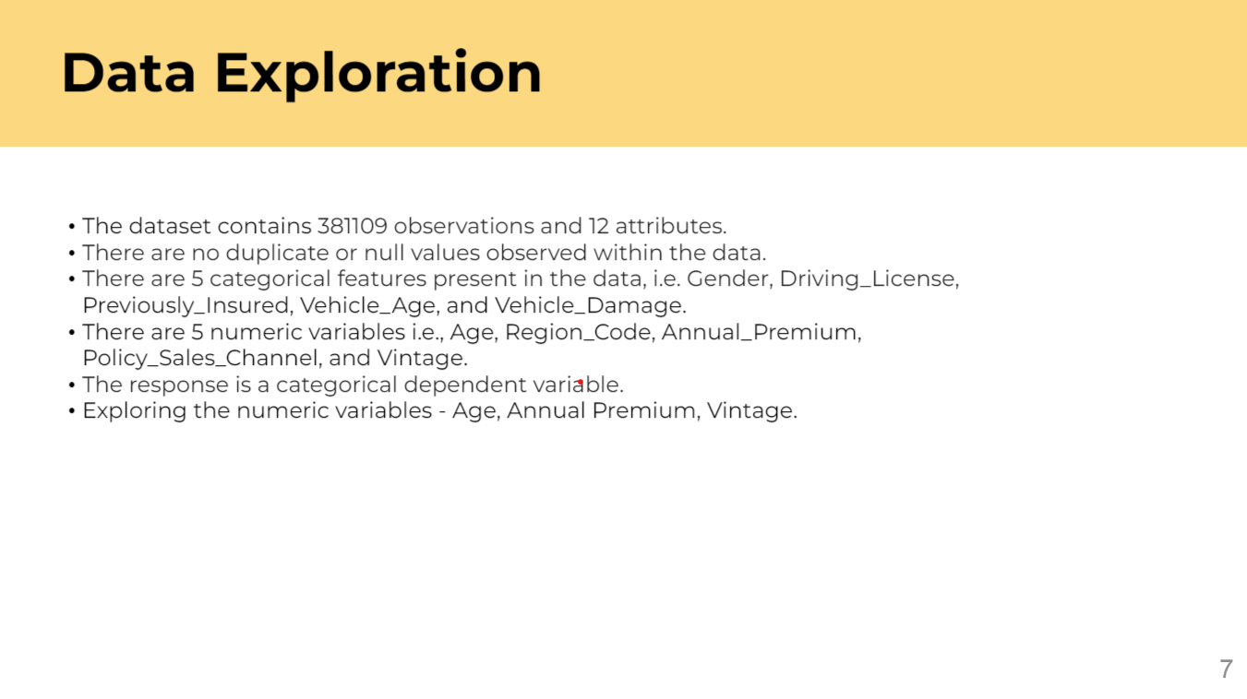

Slide 8
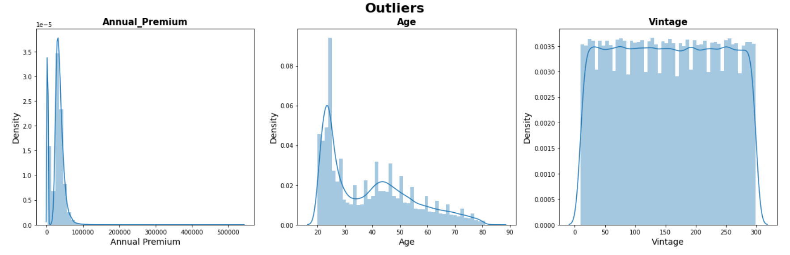
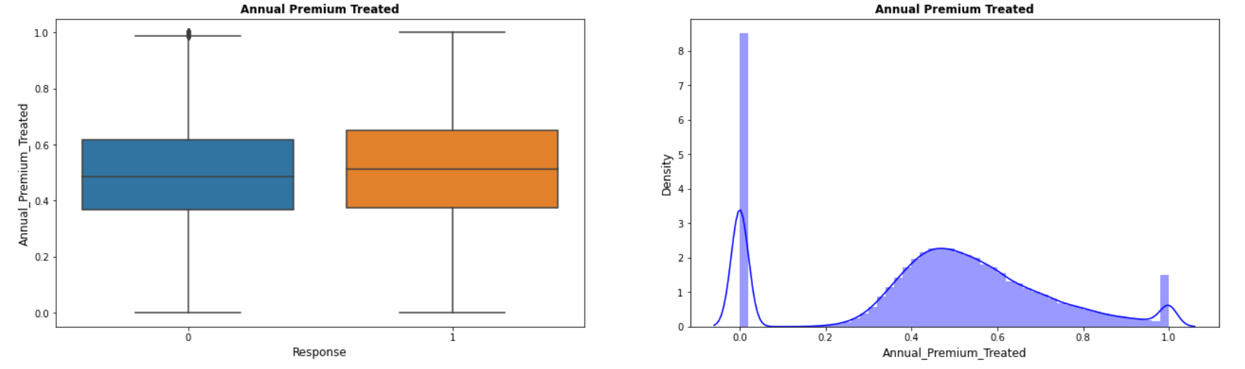
Annual Premium has a positively skewed distribution.
Age column have some outliers but they won't affect our result so we won't be treating those outliers.
Vintage column has approximate Uniform Distribution
The quantile approach method is used for treating outliers of Annual premium.
MinMaxScaler Technique is used for Normalization.

Slide 9
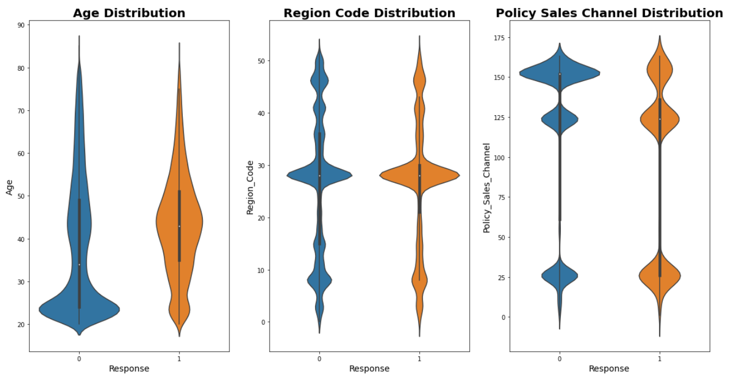
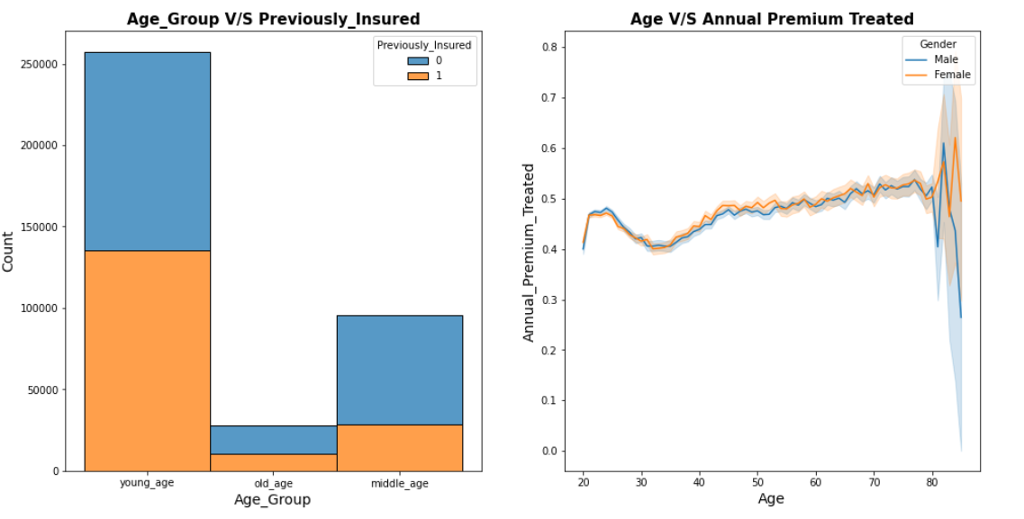
Exploratory analysis of Response variable with Age, Region_Code, Policy Sales.
Customer age of Young Group are more likely not interested in opting vehicle assurance.
Similarly, Region C and Channel A are likely not interested in taking the vehicle insurance.
Customers of young age and Old age are equally interested in having vehicle insurance, meanwhile customers of middle age have the highest chances of not having previously insured vehicle insurance.
Age v/s Annual Premium plot signifies the relation between Age and the Annual Premium for both Male and Female customers.

Slide 10
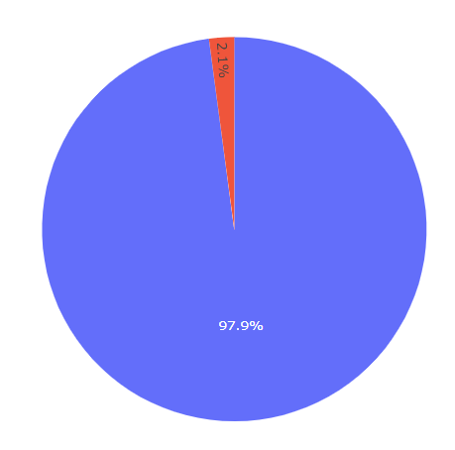
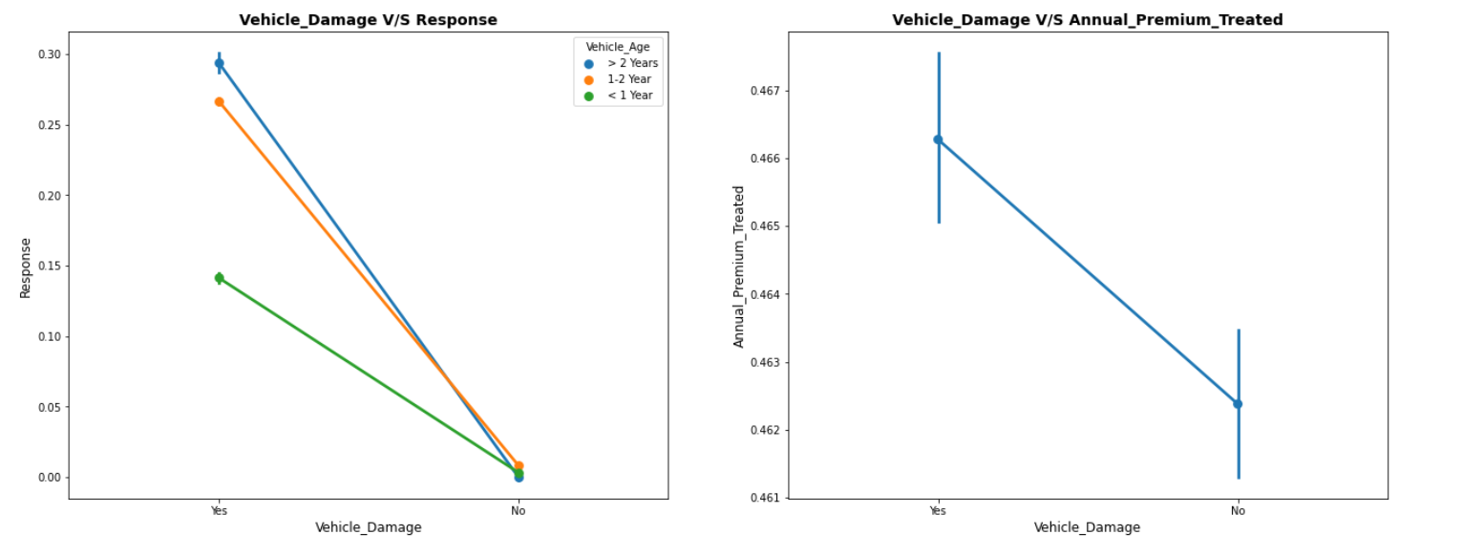
Pie Plot signifies that 97.9% of the customers with vehicle damaged or not have taken the insurance.
First point plot notifies that there are chances of taking vehicle insurance higher if the vehicle is damages, With the increase in the vehicle age, chances of vehicle insurance also increases
Second Point Plot tells us that for customers with damaged vehicle Annual Premium is comparatively higher.

Slide 11
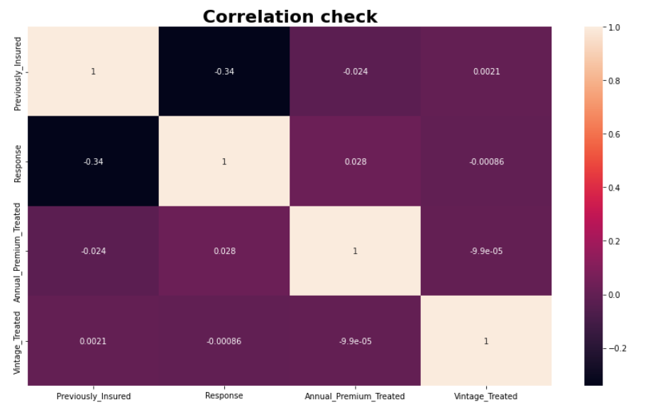
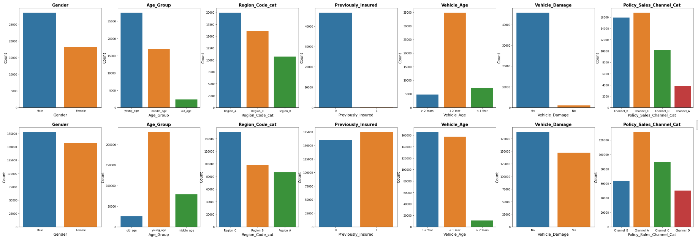
Age, Region_Code, Annual_Premium, Policy_Sales_Channel and Vintage features are categorized, so the original features are dropped.
Also droping 'ID' and 'Driving_License' as they are not providing any valuable information.
Correlation matrix signifies there is no correlation between Annual_Premium_Treated and Vintage_Treated.
11

Slide 12
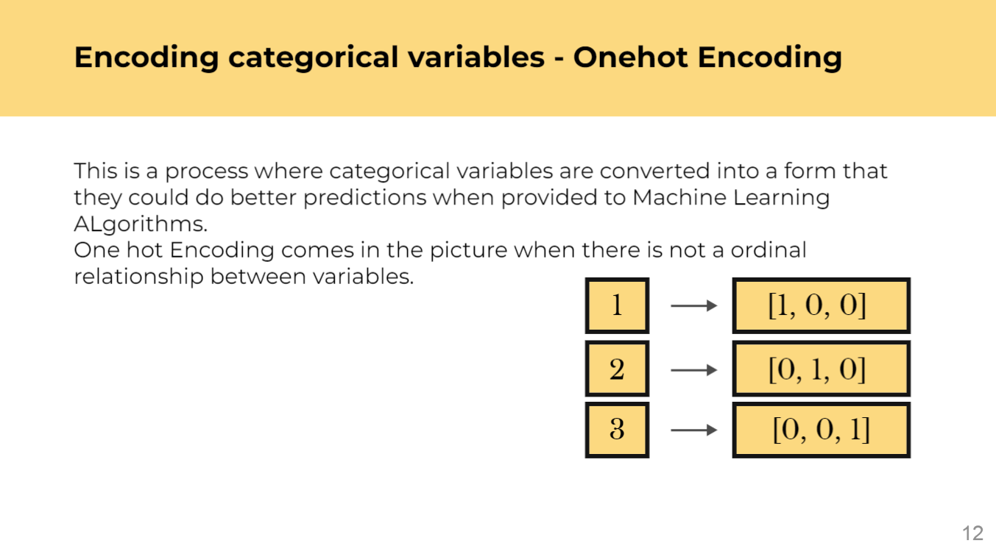

Slide 13
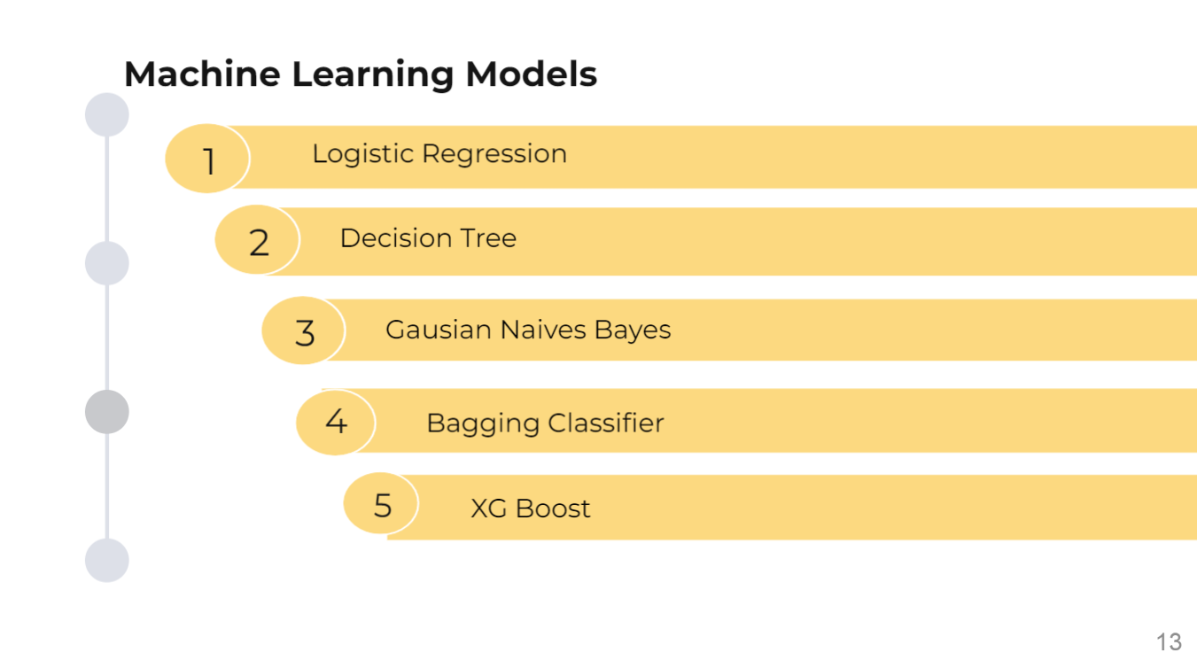

Slide 14
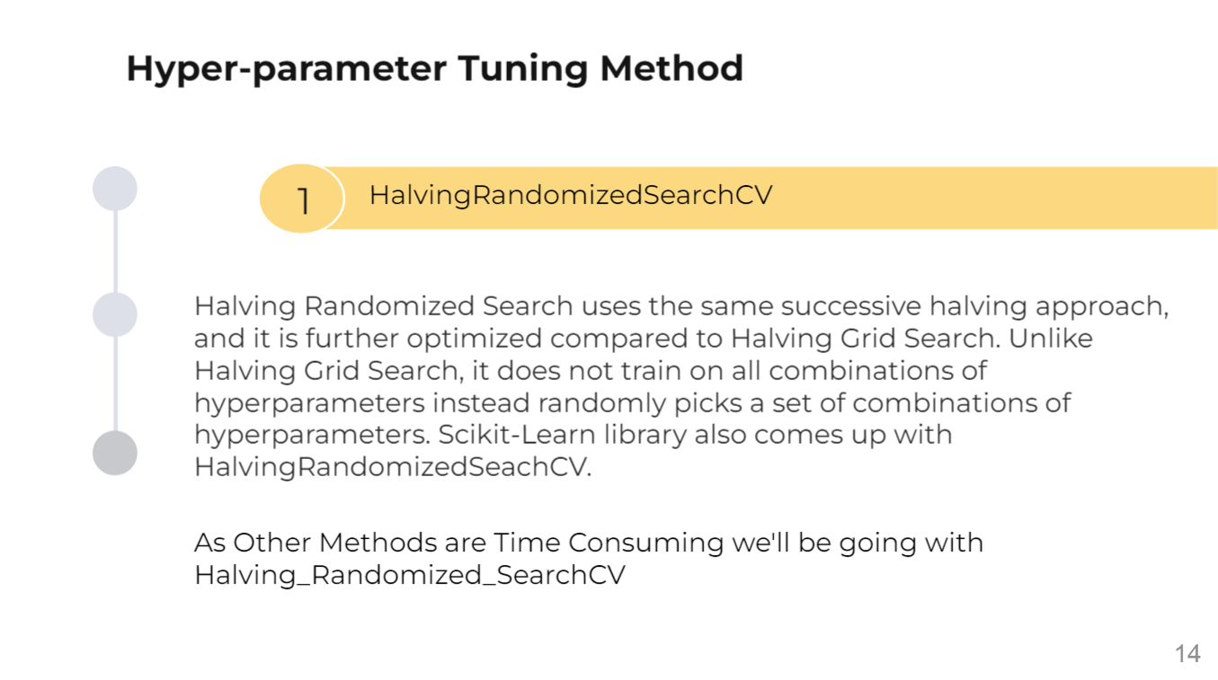

Slide 15
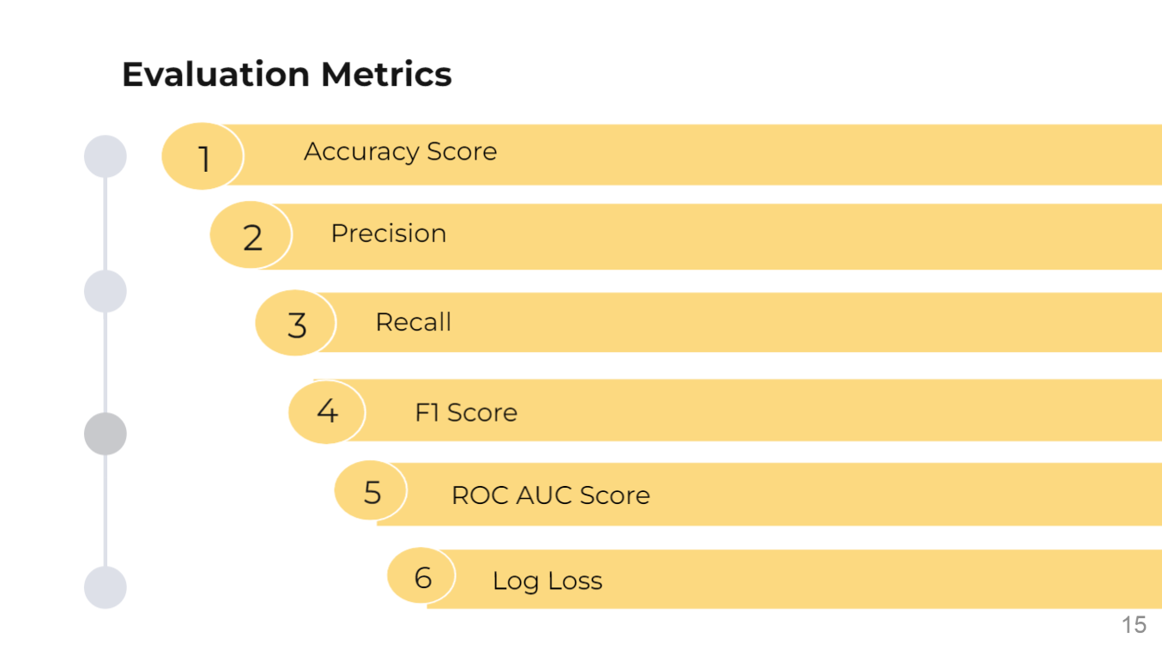

Slide 16
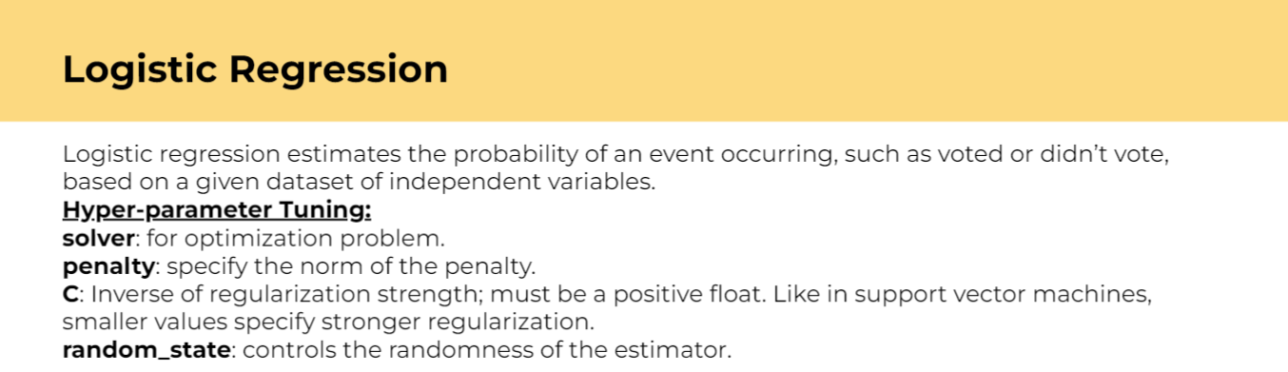
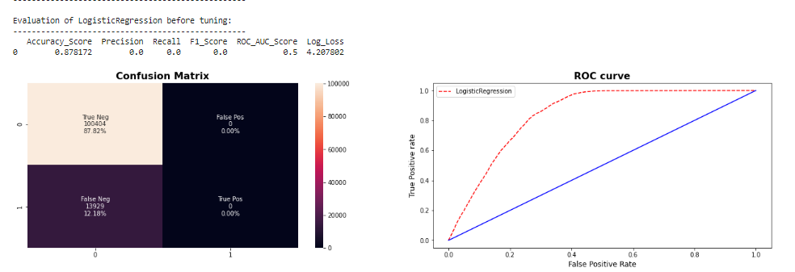
16

Slide 17
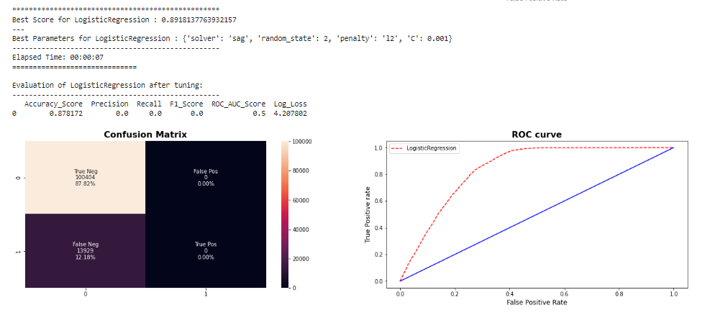
17

Slide 18
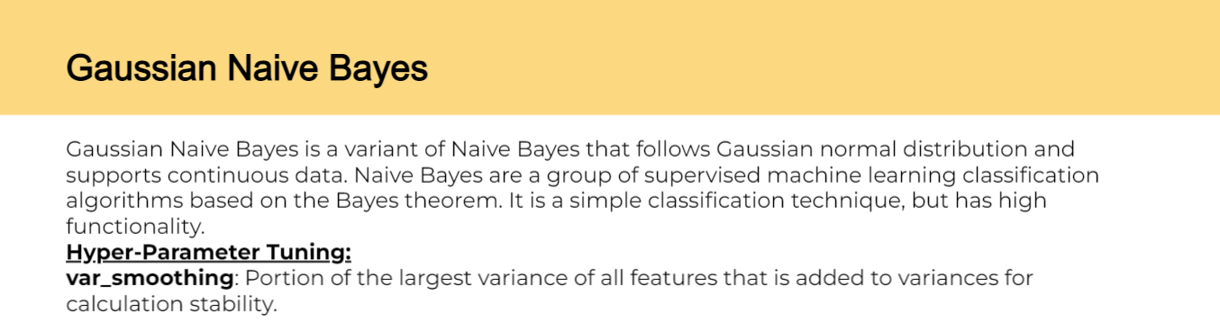
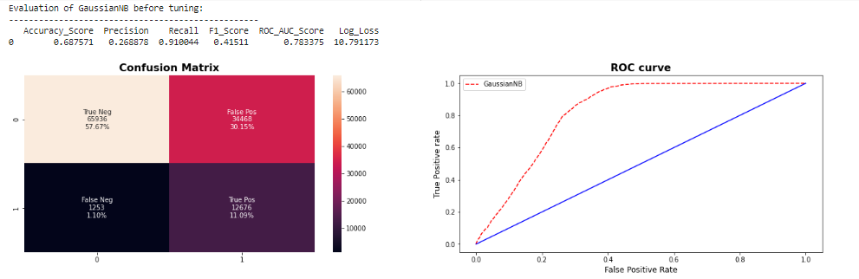
18

Slide 19
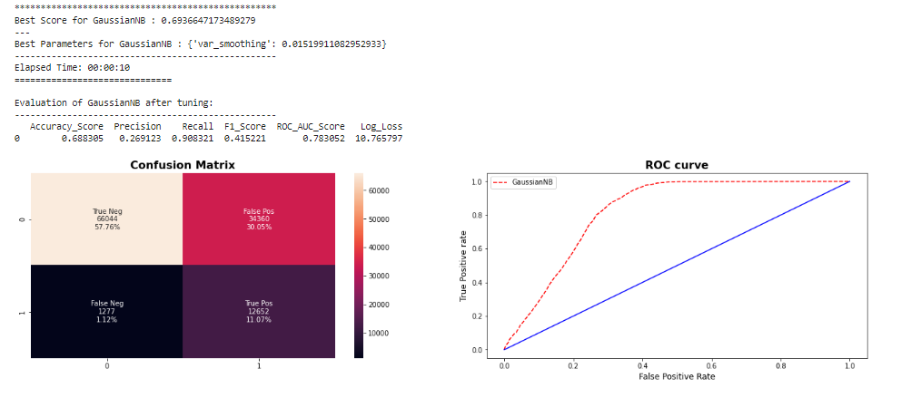
19

Slide 20
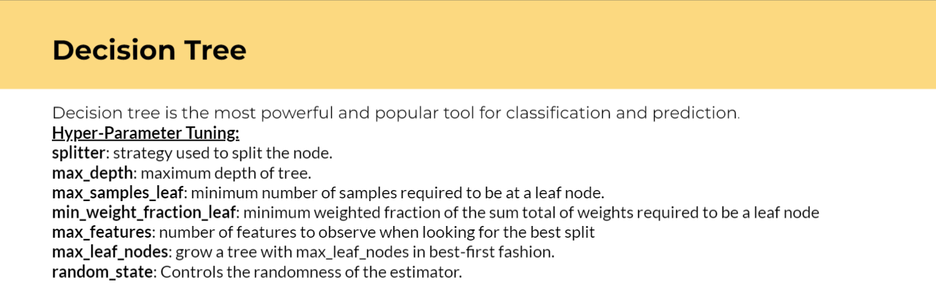
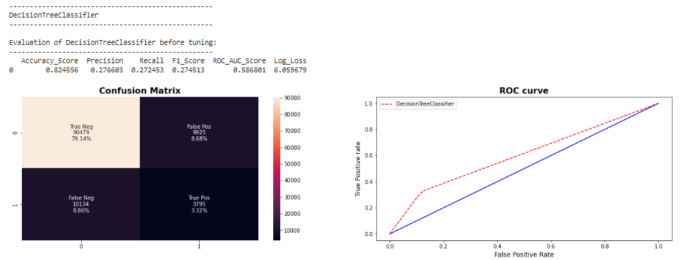
20

Slide 21
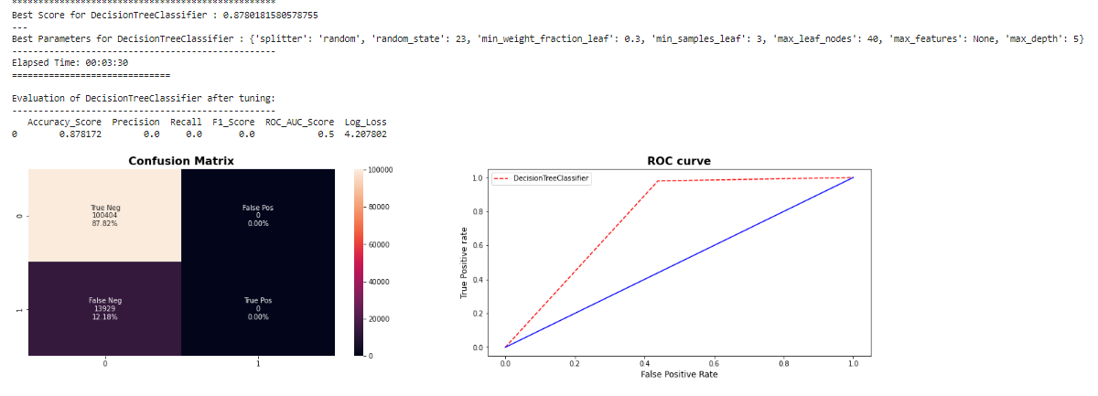
21

Slide 22
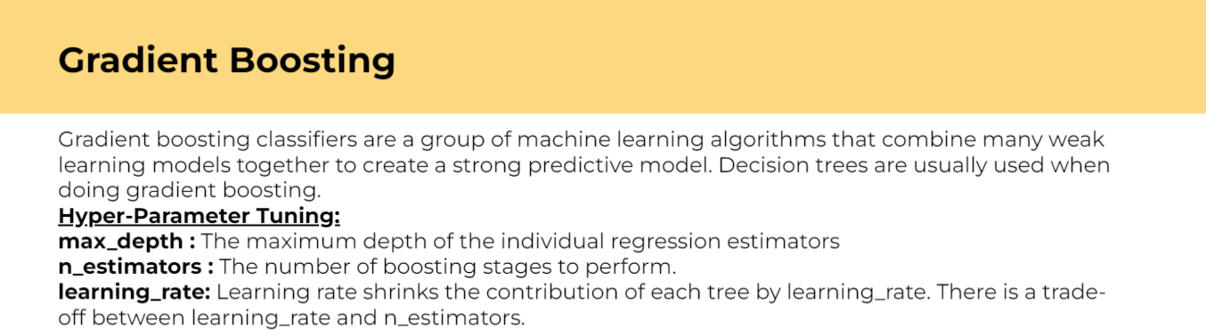
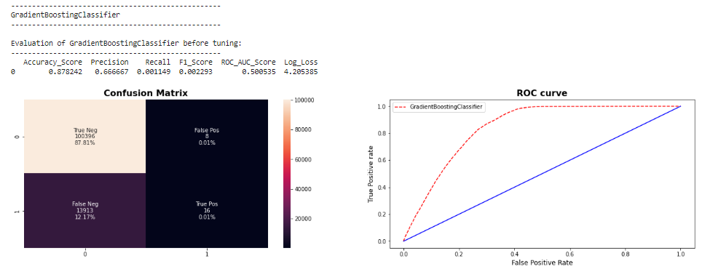
22

Slide 23
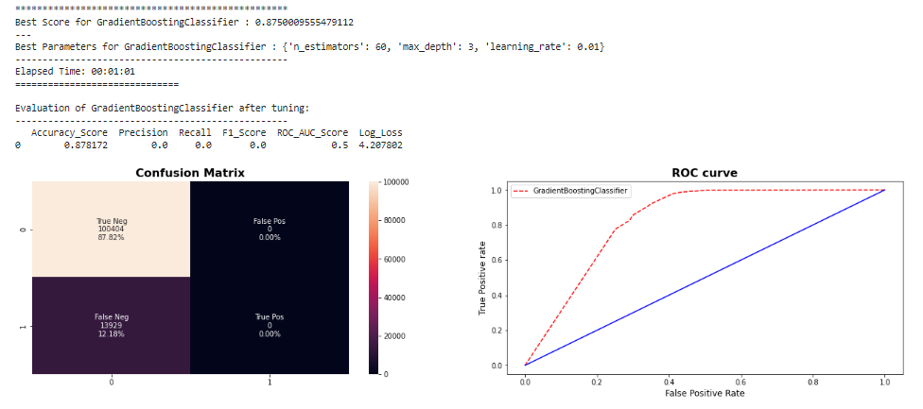
23

Slide 24
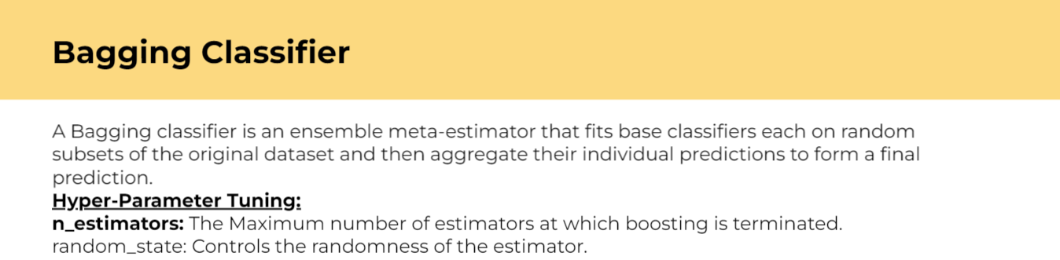
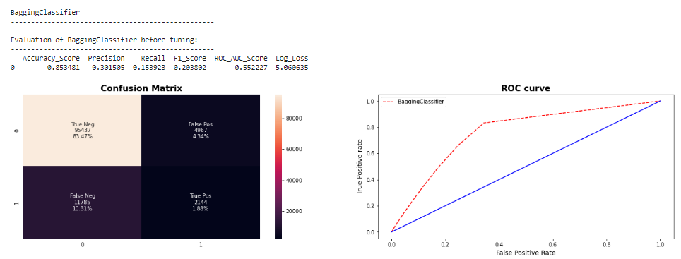
24

Slide 25
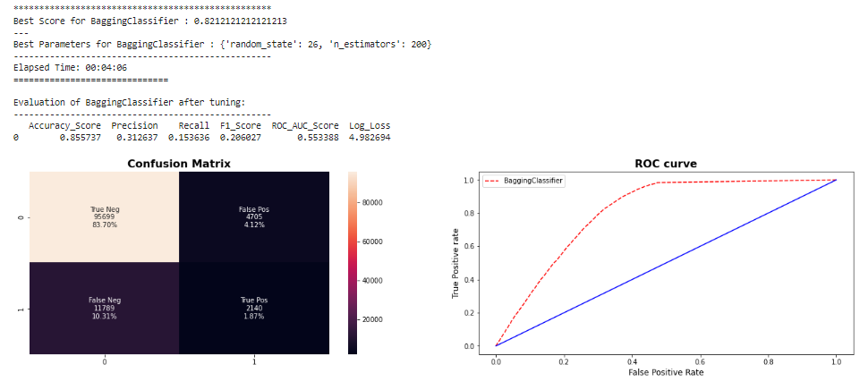
25

Slide 26
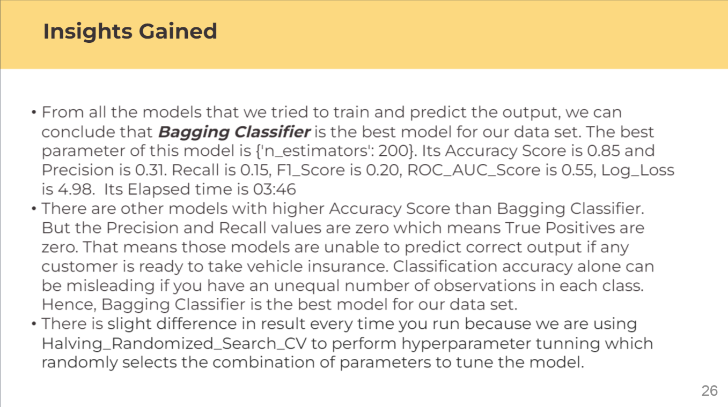

Slide 27
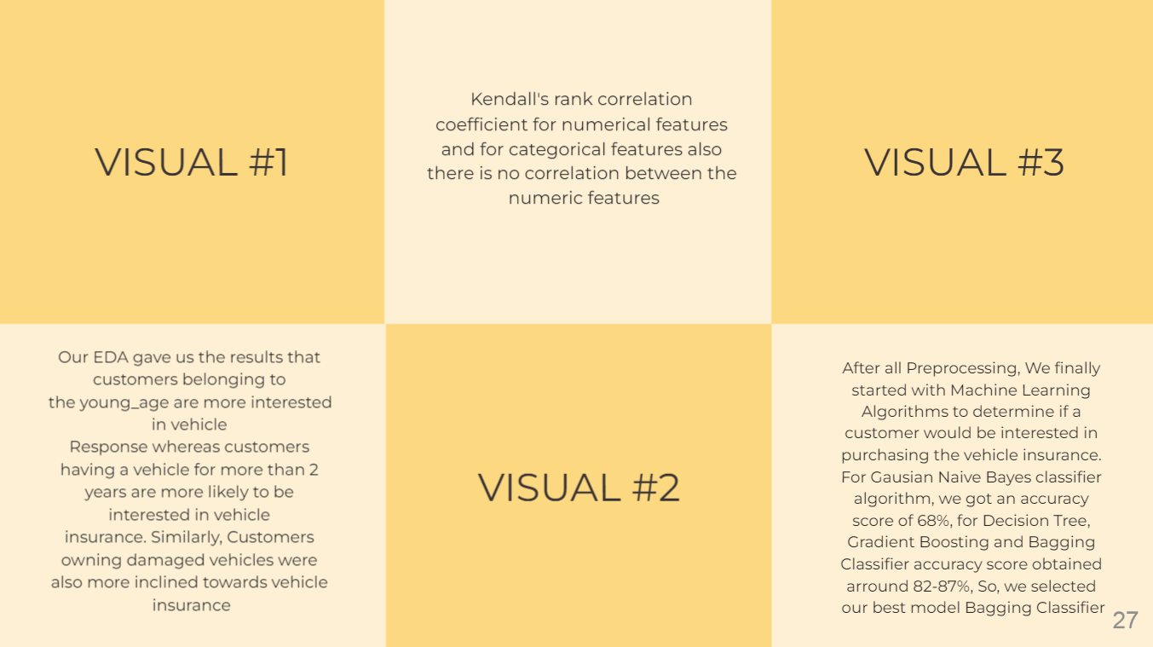

Slide 28
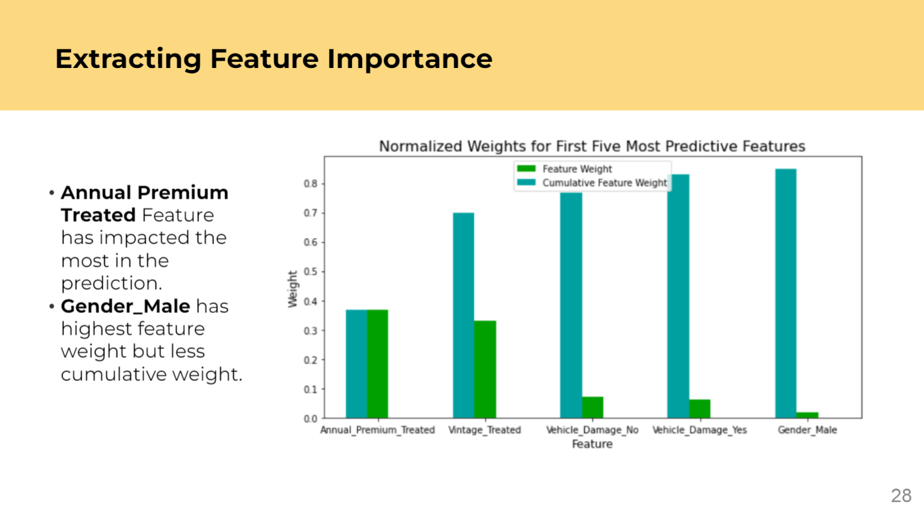

Slide 29


